Slide 1


Apple M 1 Chip

Slide 2
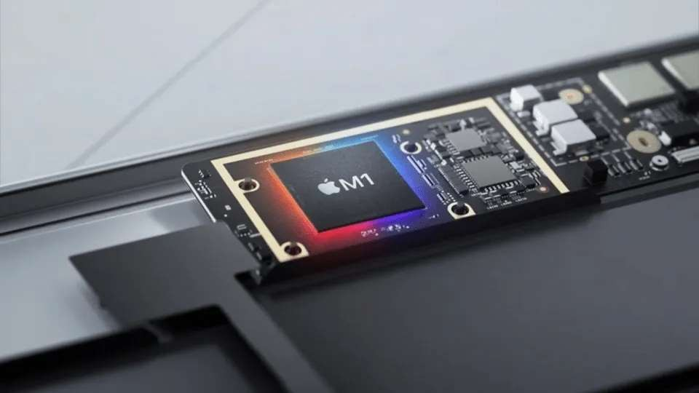
The new M1 chip
from APPLE

Slide 3

“Any sufficiently advanced technology is indistinguishable from magic.”
-Arthur C. Clarke

Slide 4
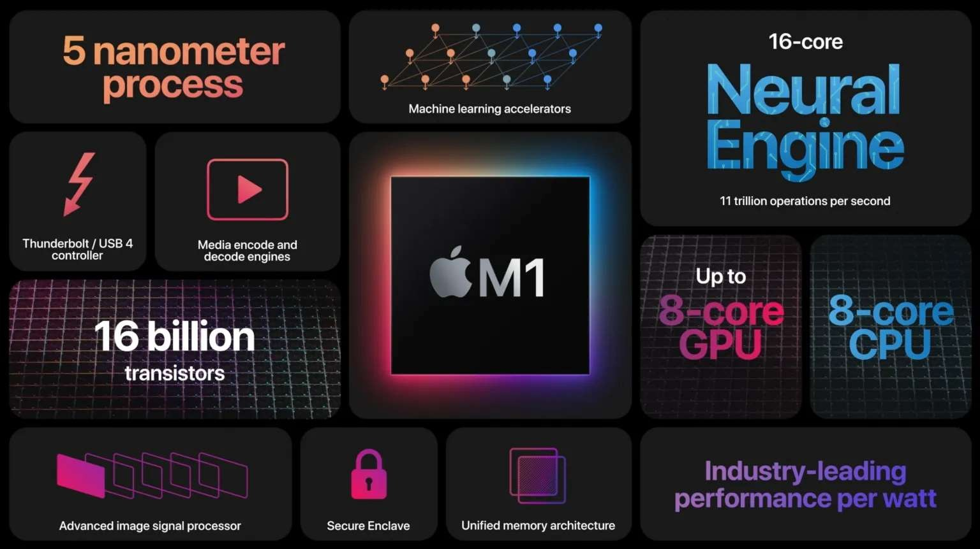
Top Features
System on Chip
16 billion Transistors on a single chip
Unified Memory Architecture 8 cores
Fastest Integrated Graphics
Nerual engine

Slide 5







ARM
The M1 chip is built on the ARM architecture, which is what is used in iPhones (iOS).
ARM systems are designed to do more while consuming
less power.

Slide 6
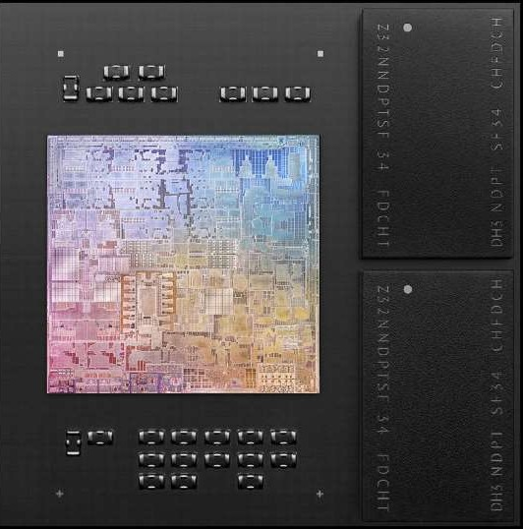
System on Chip
(SOC)
SoC means an entire system on a single chip.
With M1, processor, I/O, security and memory
and other technologies are combined into a single system on a chip (SoC).
The M1 chip uses a 5-nanometer production process.
Intel’s latest 11th-generation CPUs use a 10-
nanometer production process .

Slide 7
16 billion Transistors
on a Single chip

Slide 8
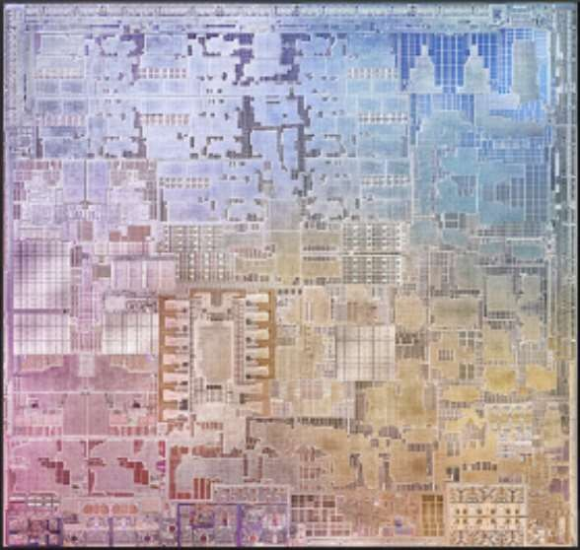
16 billion transistors
on M1
There are 16billion transistors on a single M1 chip .
Meanwhile, there are 7billion trasistors of intel latest processor,i9.

Slide 9
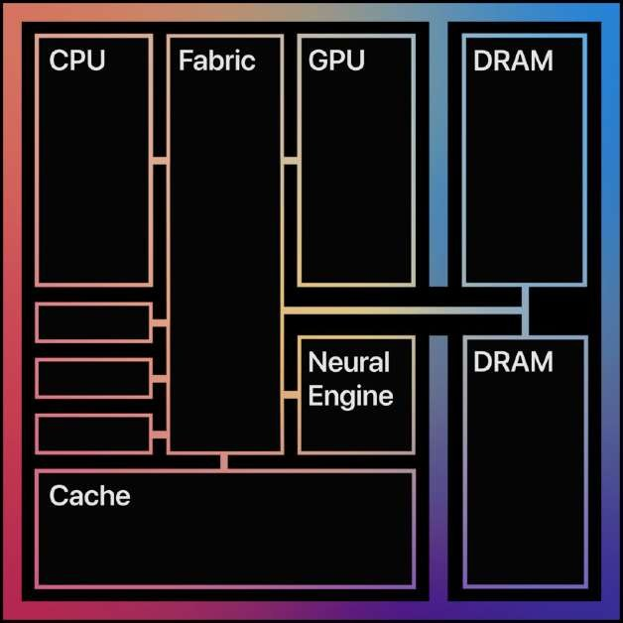
Unified Memory Architecture (UMA)
M1 features a unified memory architecture.
As a result, all of the technologies in the SoC can access the same data without copying it between multiple pools of memory.
This improves performance and power efficiency.
But the downside is users will not be able to Increase RAM or Main Memory size.

Slide 10

SoC made possible by
16 billions transisitors on a single chip
System on a Chip
5-nanomater production process.
Unified Memory Architecture

Slide 11
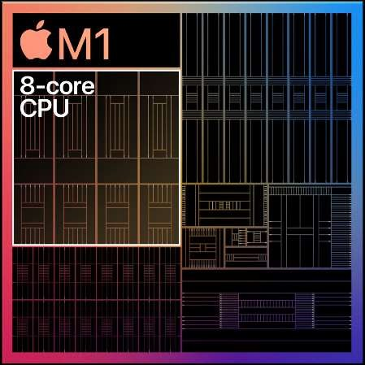
8 Cores on M1
M1 features four performance cores.
M1 has four efficiency cores to handle lighter workloads

Slide 12
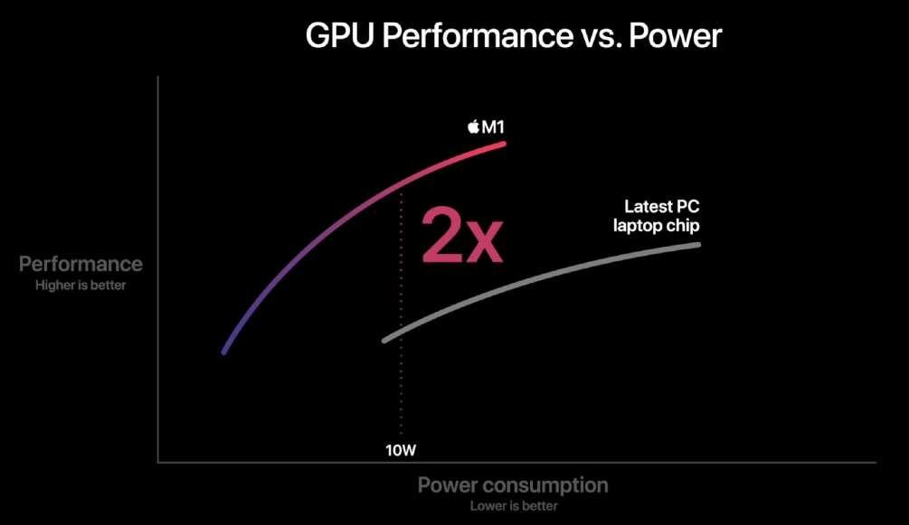
Apple cliams the M1 chip is TWICE faster than Intel's latest chip.

Slide 13
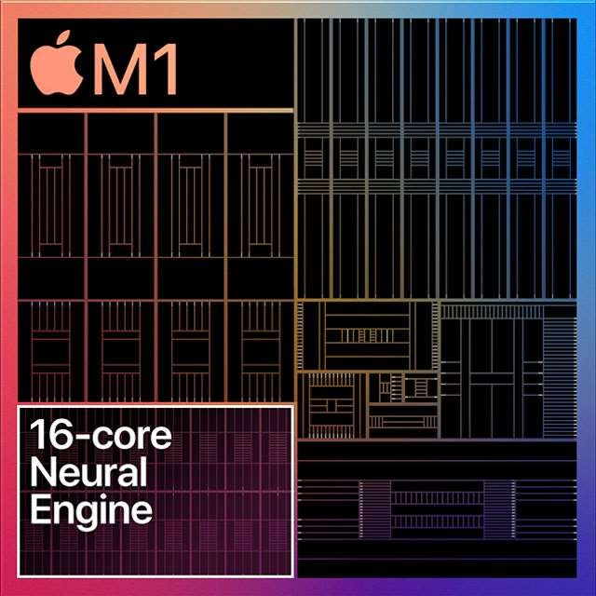
Neural Engine
on M1
Apple claims, the 16-core design is capable of executing a massive 11 trillion operations per second.
Apps such as Final Cut pro, Pixelmator Pro and other apps with Machine learning powered
features will be much faster while using machine learning powered tasks.

Slide 14
Conclusion
Till now the CPU market is mostly dominated by Intel for PCs and Macs, but now as Apple has also brought its own chip commercially, we can expect good competition and eventually benefiting the consumers and users from both performance and budget vice.

Slide 15
Thanks!
Any questions?

